Slide 1

Two Ways of Making Variables - tf.Variable vs tf.get_variable

Slide 2
Reference
Youtube on tf.get_variable
Youtube on tf.variable_scope
Youtube on Sharing Variables
Code

Slide 3
tf.Variable vs tf.get_variable

Slide 4
I'd recommend to always use tf.get_variable(...) -- it will make it way easier to refactor your code if you need to share variables at any time, e.g. in a multi-gpu setting (see the multi-gpu CIFAR example). There is no downside to it.
stackoverflow

Slide 5
tf.Variable always makes a new variable

Slide 6
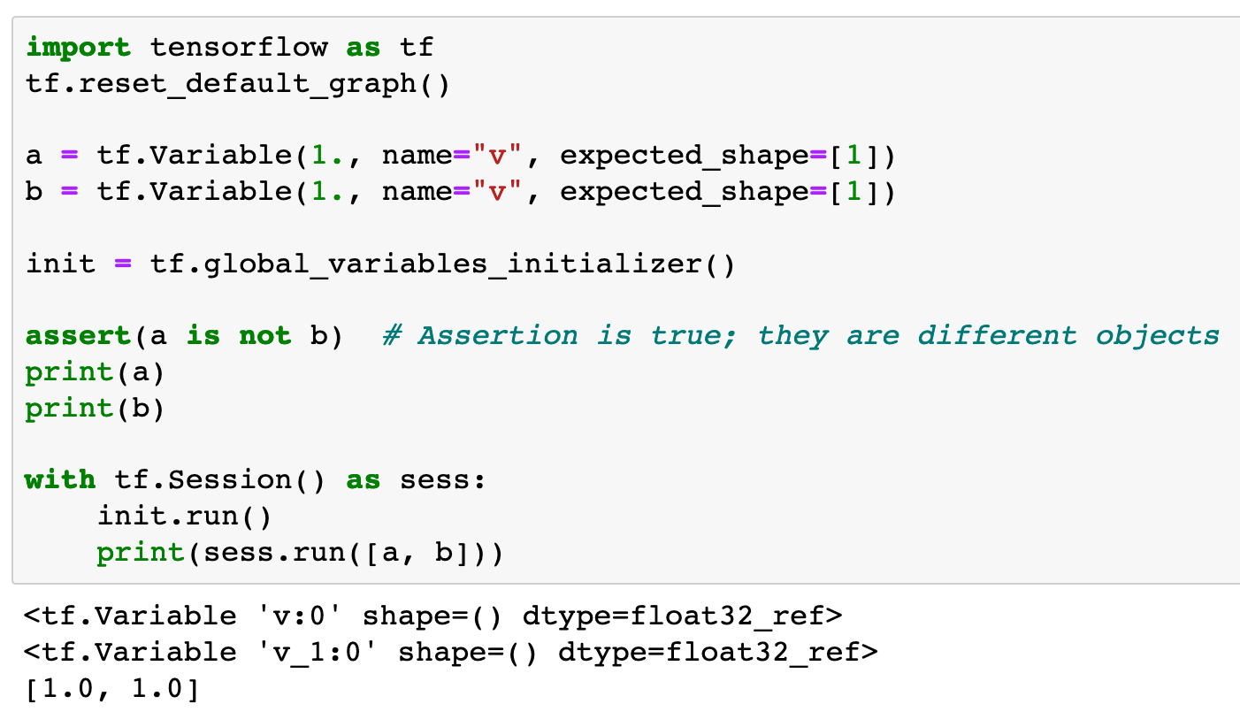



Slide 9
tf.get_variable either makes a new variable or reuses

Slide 10
Case 1: If there is no variable with given name (including prefix) used yet,
it creates a new one.
Case 2: If there is a variable with given name (including prefix) used before
and if we declare to reuse,
it uses or shares the old one.
Case 3: If there is a variable with given name (including prefix) used before
but if we don't declare to reuse,
it raises ValueError.

Slide 11
ValueError: Variable v already exists, disallowed.

Slide 12
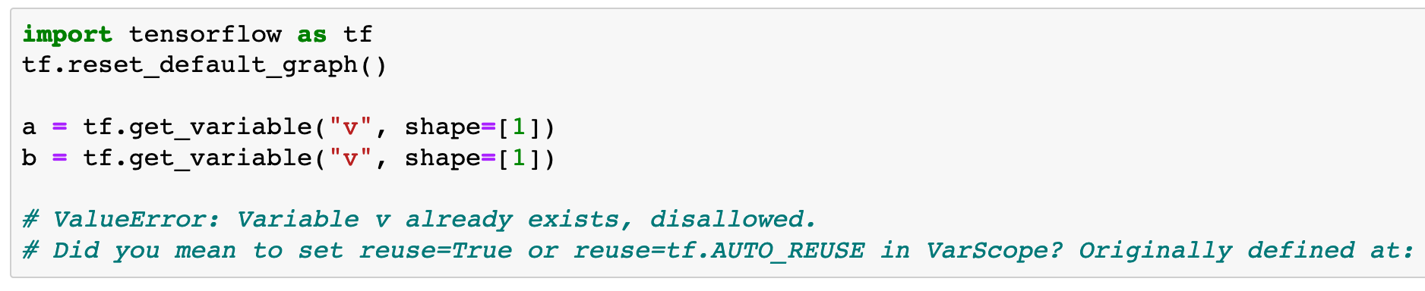

Slide 13
ValueError: Variable v already exists, disallowed.

Slide 14
tf.Variable: Must have initial values.
tf.get_variable: No initialization is allowed so that...

Slide 15
tf.Variable: Must have initial values.
tf.get_variable: No initialization is allowed so that...

Slide 16
TypeError: get_variable() got an unexpected keyword argument 'reuse'

Slide 17
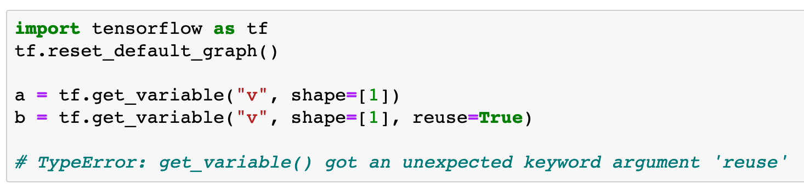

Slide 18
TypeError: get_variable() got an unexpected keyword argument 'reuse'

Slide 19
ValueError: Variable v already exists, disallowed.

Slide 20
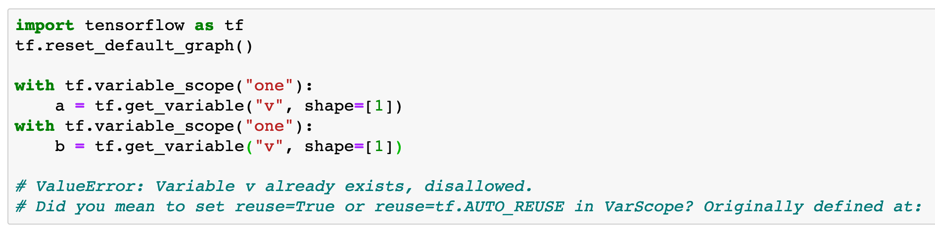

Slide 21
ValueError: Variable v already exists, disallowed.

Slide 22
Sharing Variables Success!

Slide 23
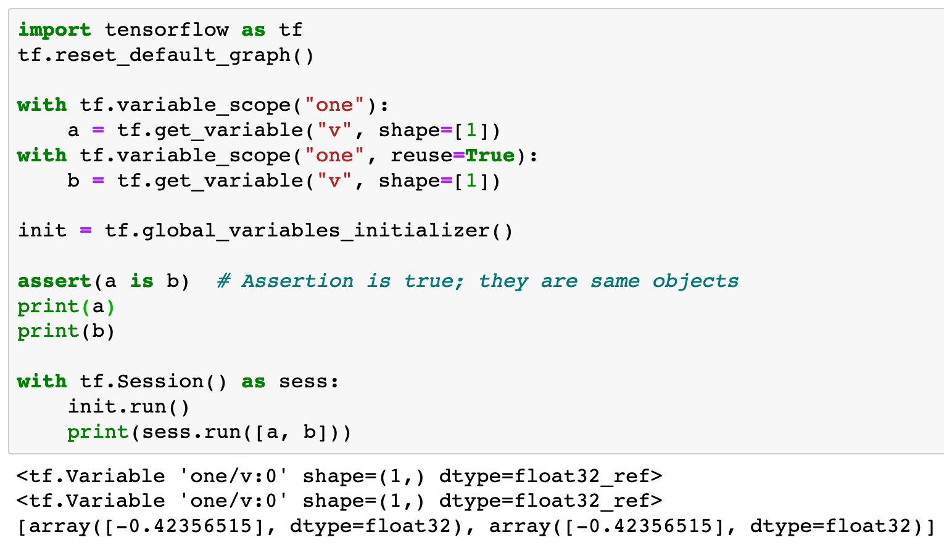

Slide 24
resue=True

Slide 25
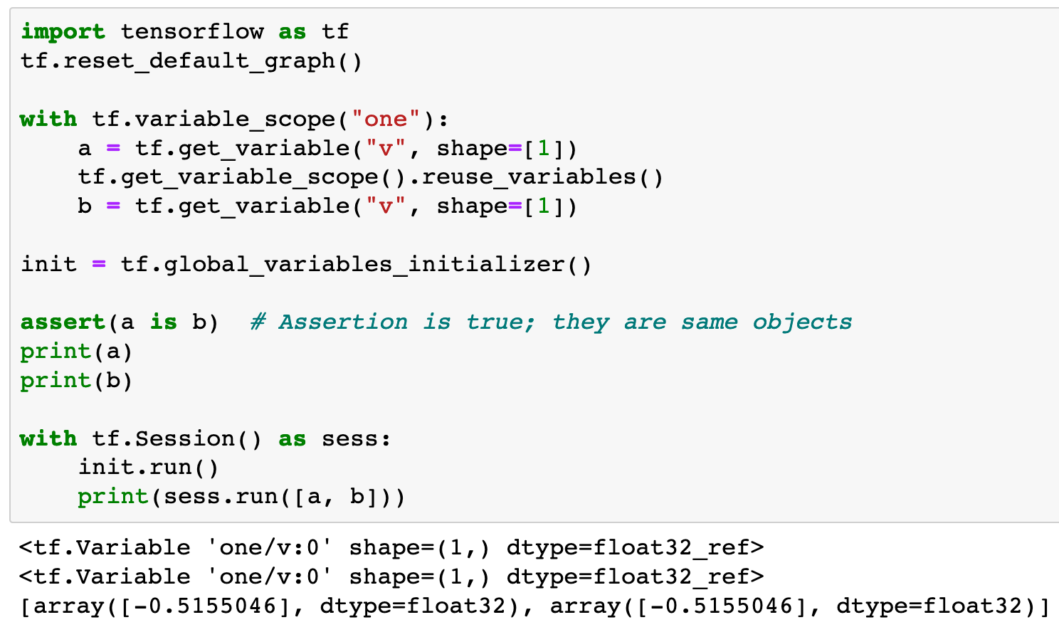

Slide 26
reuse variables
in the same variable scope

Slide 27
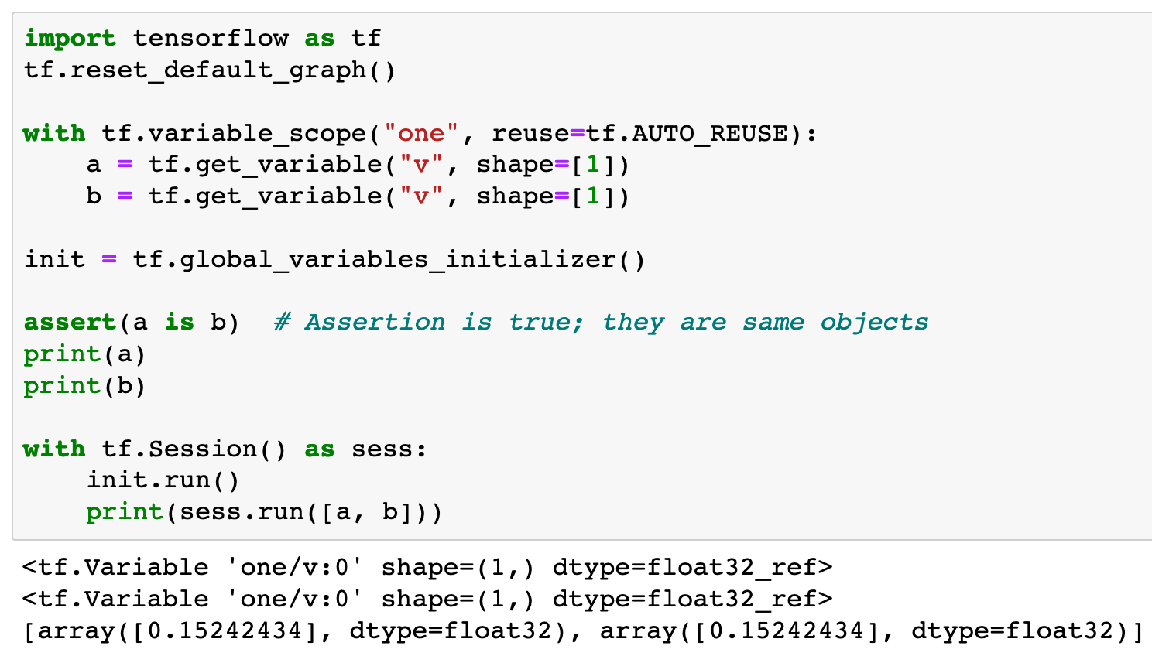

Slide 28
reuse variables
in the same variable scope
automatically

Slide 29
Now
Let’s Play with Code

